Slide 1

Project Work - II
Department of Computer Science and Engineering
OFF - CAMPUS Internship
from
“ RWS Moravia India Private Limited”
Submitted To: Submitted By:
Dr. Kailash Bandhu Pragya Sardar
Mr. Binod K Mishra EN18CS301171

Slide 2
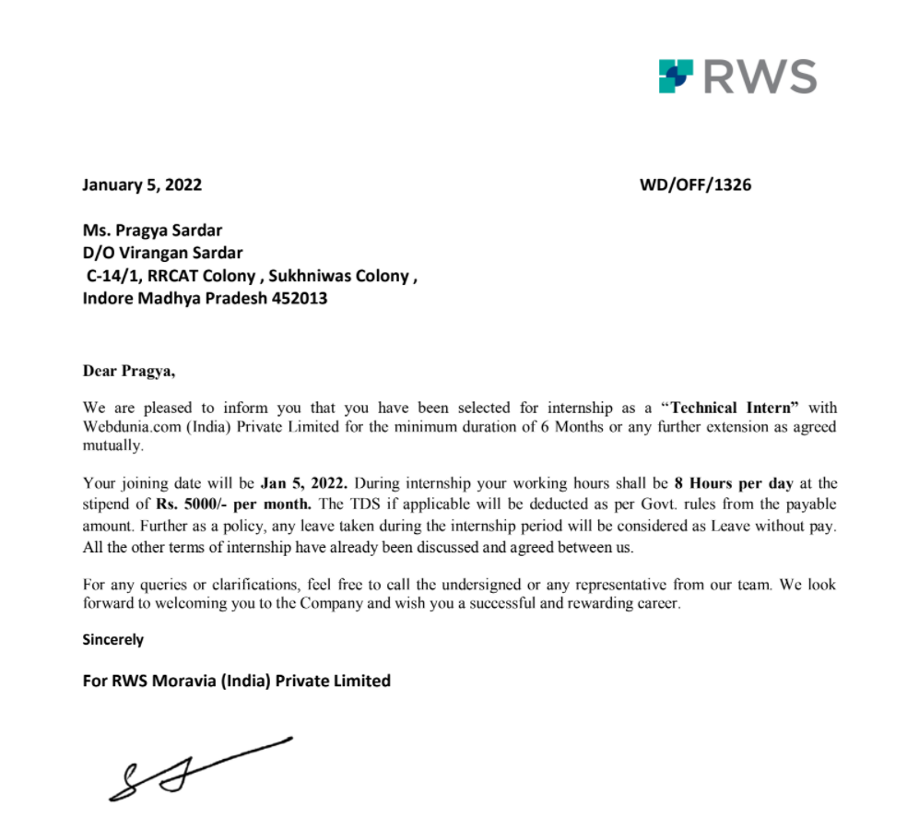
Offer Letter

Slide 3
Contents
Company Profile
Apache Spark
Apache Spark - GraphX
The Property Graph
Property Graph Example
GraphX Operators
Spark GraphX Implementation
Project Description

Slide 4

About RWS MORAVIA
RWS Moravia is a leading globalization solutions provider, enabling companies in the IT, consumer electronics, retail, media and entertainment, and travel and hospitality industries to enter global markets with high-quality multilingual products and services.
RWS Moravia’s solutions include localization, testing, content creation, machine translation implementations, technology consulting, and global digital marketing services.
Website : https://www.rws.com/

Slide 5

Apache Spark
Apache Spark is an open-source, distributed processing system used for big data workloads.
It provides development APIs in Java, Scala, Python and R, and supports code reuse across multiple workloads—batch processing, interactive queries, real-time analytics, machine learning, and graph processing.
FEATURES:
Fast Processing
Flexibility
In-memory computation
Real Time Processing
Fault Tolerance in Spark
Advance Analytics

Slide 6
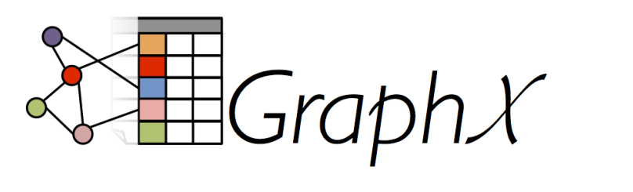
Apache Spark - GraphX
GraphX is a new component in Spark for graphs and graph-parallel computation.
At a high level, GraphX extends the Spark RDD by introducing a new Graph abstraction: a directed multigraph with properties attached to each vertex and edge.
To support graph computation, GraphX exposes a set of fundamental operators (e.g., subgraph, joinVertices, and aggregateMessages) as well as an optimized variant of the Pregel API. In addition, GraphX includes a growing collection of graph algorithms and builders to simplify graph analytics tasks.

Slide 7
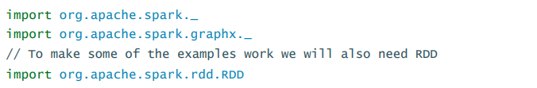
Getting Started
To get started you first need to import Spark and GraphX into your project, as follows:

Slide 8
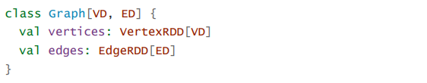
The Property Graph
The property graph is a directed multigraph with user defined objects attached to each vertex and edge.
Each vertex is keyed by a unique 64-bit long identifier (VertexId). GraphX does not impose any ordering constraints on the vertex identifiers. Similarly, edges have corresponding source and destination vertex identifiers.
The classes VertexRDD[VD] and EdgeRDD[ED] extend and are optimized versions of RDD[(VertexId, VD)] and RDD[Edge[ED]] respectively.

Slide 9
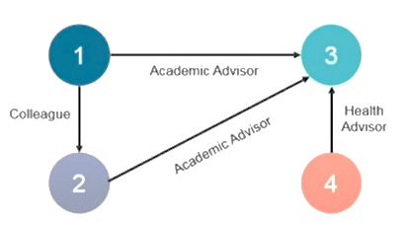
The Property Graph - Example
ID | Property (V)
1 | (Thomas, Professor)
2 | (Frank, Professor)
3 | (Jenny, Student)
4 | (Bob, Doctor)
ScrID | DstID | Property (E)
1 | 3 | Academic Advisor
4 | 3 | Heath Advisor
1 | 2 | Colleague
2 | 3 | Academic Advisor

Slide 10
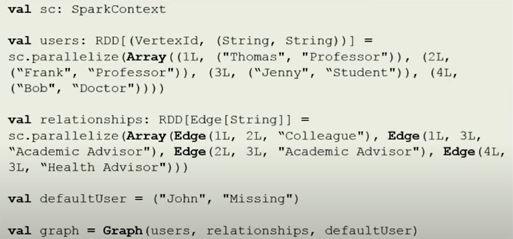
The Property Graph - Example

Slide 11
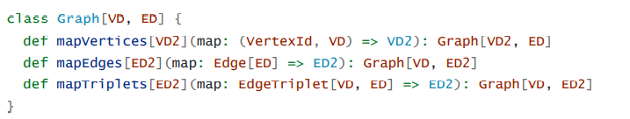
Graph Operators
The property graphs also have a collection of basic operators that take user defined functions and produce new graphs with transformed properties and structure.
PROPERTY OPERATORS

Slide 12
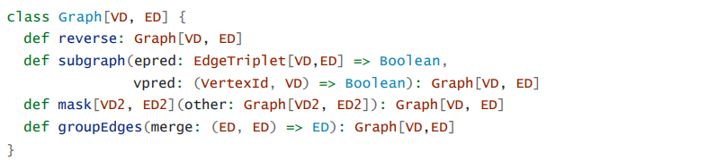
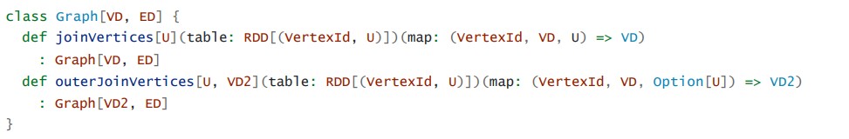
Graph Operators
STRUCTURAL OPERATORS
JOIN OPERATORS

Slide 13
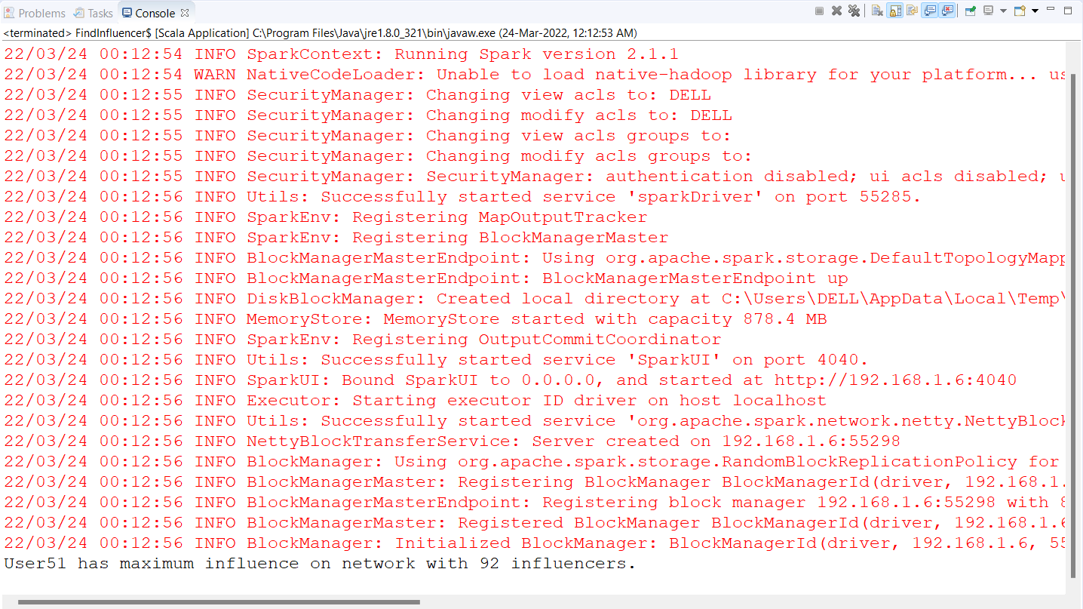
Spark GraphX Implementation

Slide 14
Project Description

Slide 15
Thank You!

